Slide 1
2013 Grand Slams data
Önder türe

Slide 2

Grand slams data
Data is from UC Irvine Machine Learning Repository.
There is 8 different csv file for 4 different grand slam group by gender.
All csv file have 42 variable.
For the Project, all csv file combined and created one data with 2 more variables as ’Tournament’ and ‘Gender’

Slide 3
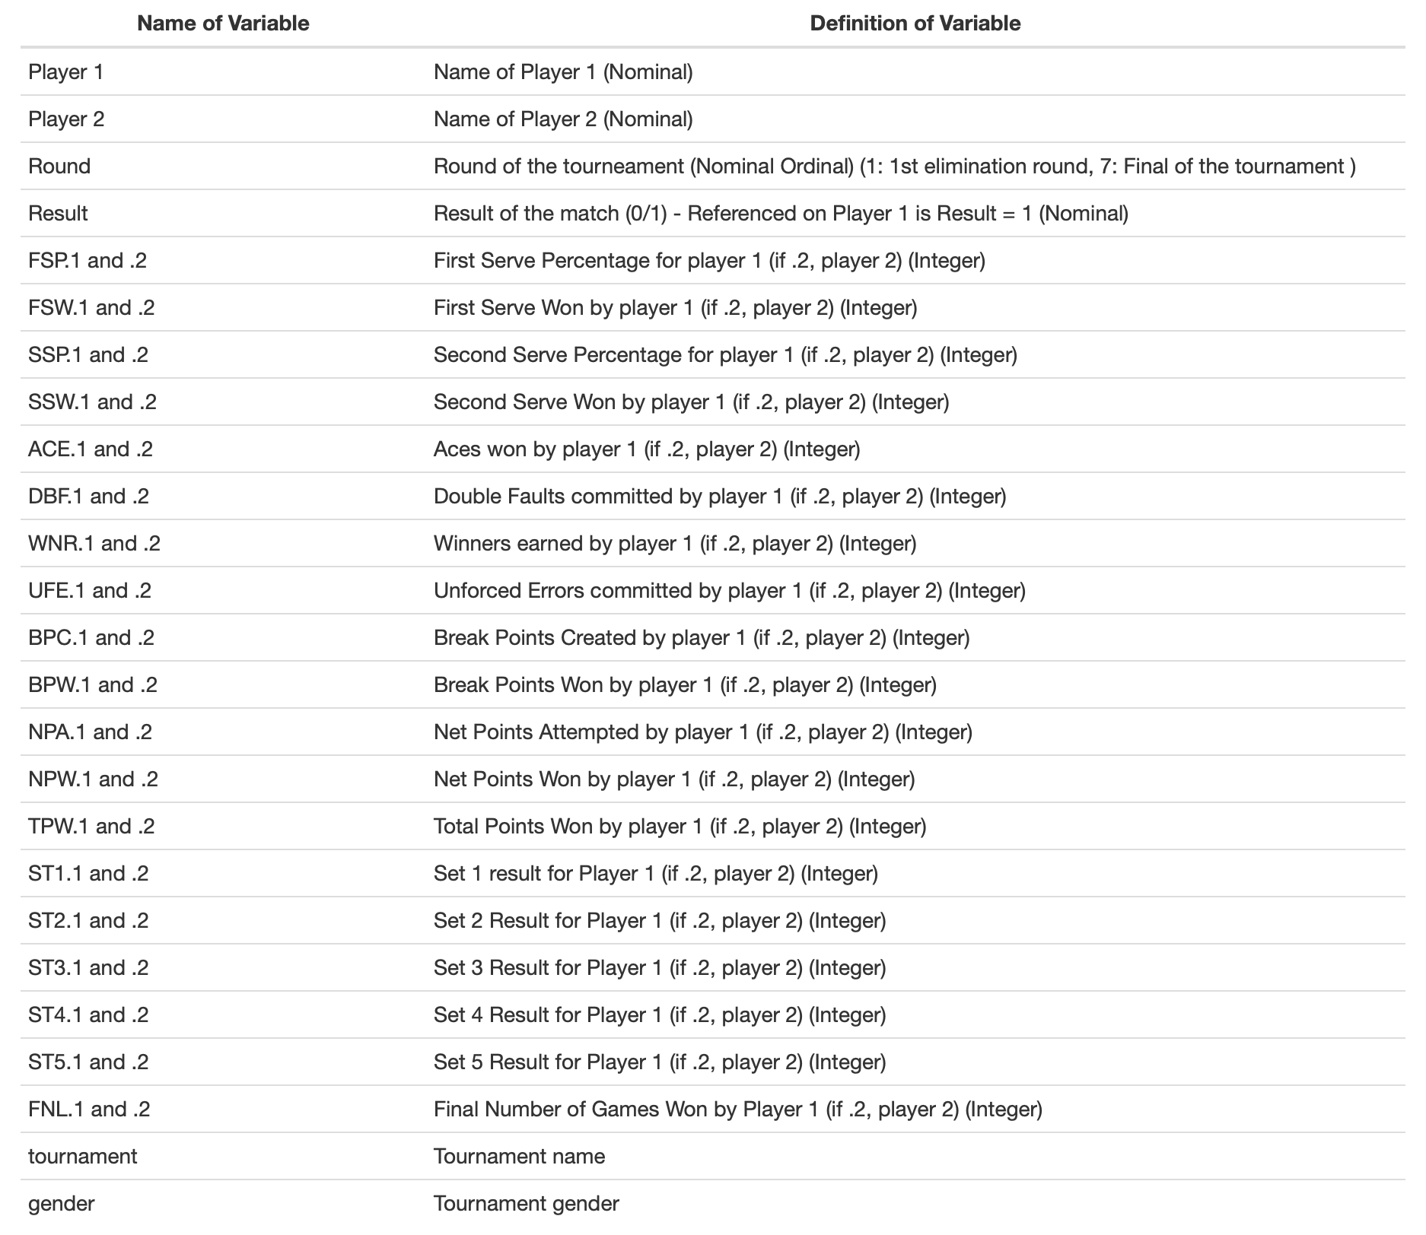
VarIables
There is 44 variables and our dependent variable is ‘Result’
Data formed by 943 rows.

Slide 4
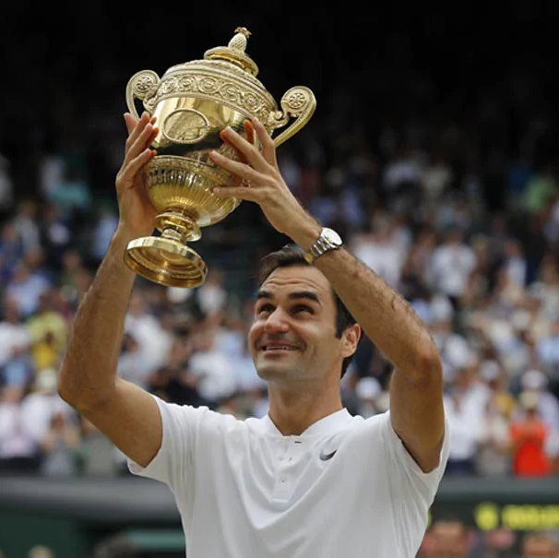
Aım of the project
Aim of the project is predict the result of the tennis match by using different match statistics.
Another aim is to find most effective match statistics for the win, and how is change for different tournament and gender.

Slide 5
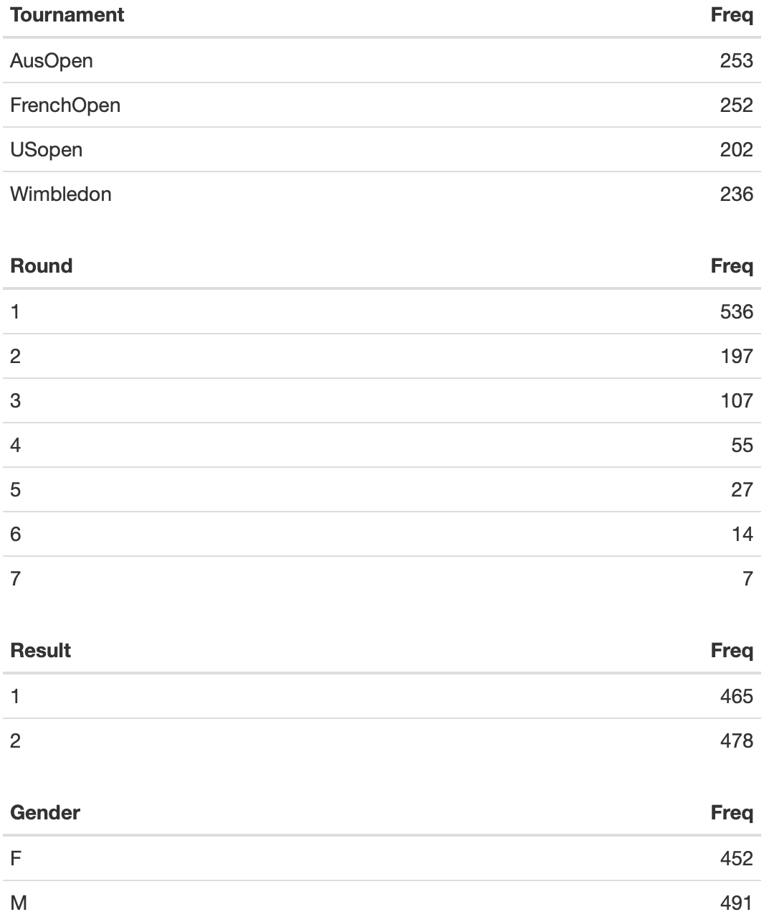
Summary statıstıcs
Dataset have 5338 NA value. %12.9 of observations are NA.

Slide 6
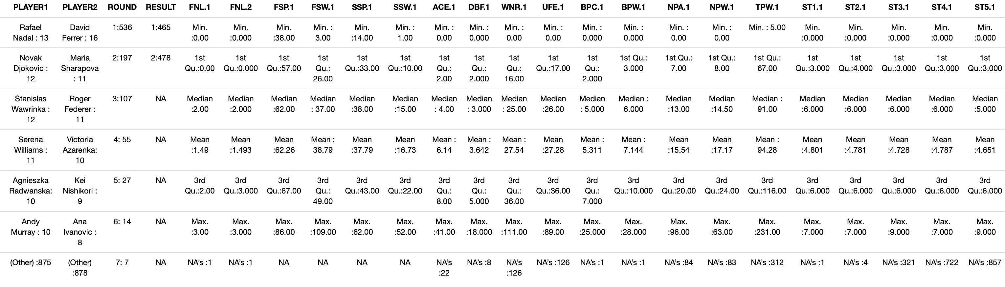
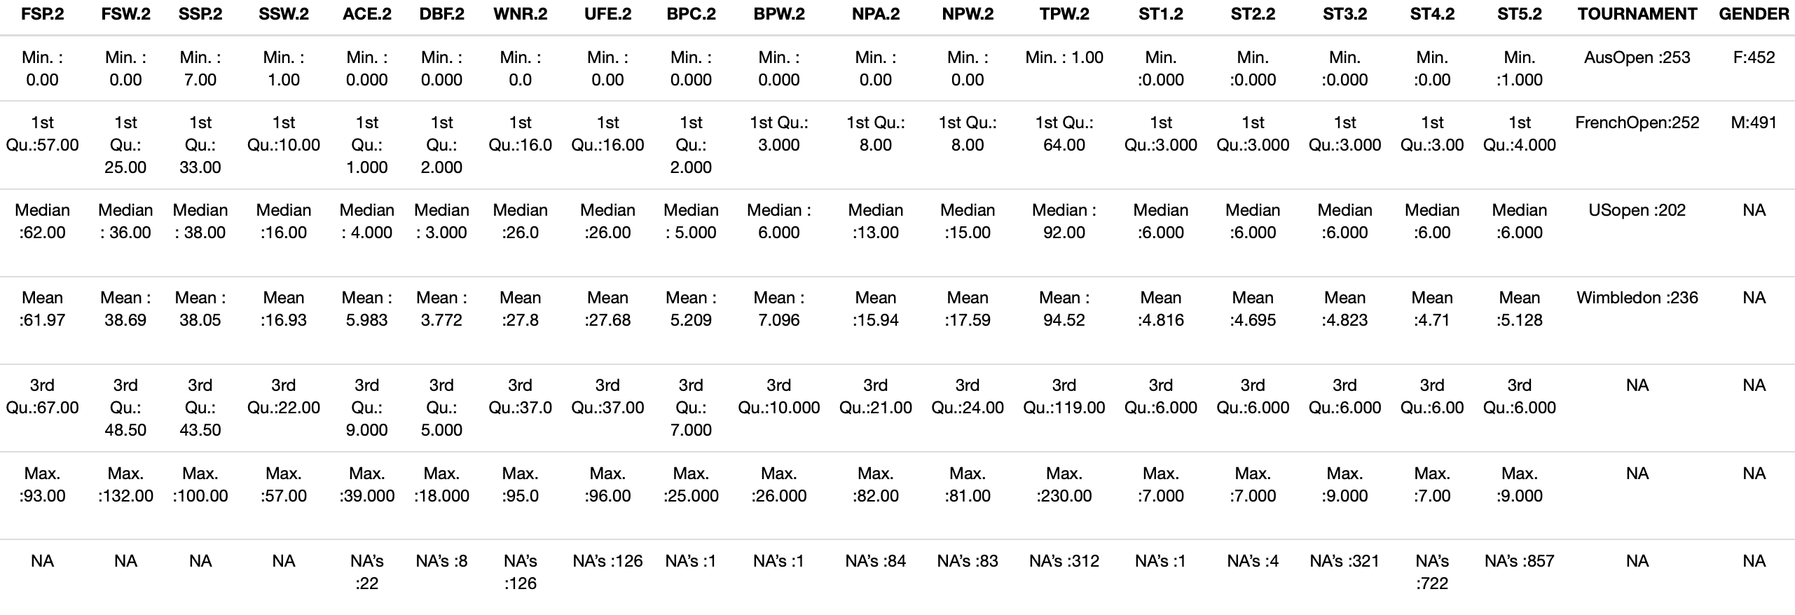
Summary statıstıcs

